Slide 1


Characterising Groundwater Recharge from Cave Terrestrial LiDAR and Drip Water Analysis
K. Mahmud ¹, G. Mariethoz ², A. Baker ¹, P. Treble ³, M. Markowska ³ and E. McGuire ⁴
¹ Connected Waters Initiative (CWI) Research Centre, University of New South Wales, Sydney, NSW, Australia
² Institute of Earth Surface Dynamics, University of Lausanne, Switzerland
³ Australian Nuclear Science and Technology Organization (ANSTO), Lucas Heights, NSW, Australia
⁴ Department of Parks and Wildlife, WA, Australia
Presented By
Kashif Mahmud PhD student
CWI, UNSW, Sydney, Australia
Notes:
I would like to welcome you all to this morning session on ‘Caves’ focusing mainly on the issues related to Groundwater Recharge and Climate.
I would like to introduce the first topic “Characterising Groundwater Recharge from Cave Terrestrial Lidar and Drip Water Analysis”.
From the title it is clearly evident that we have used two emerging techniques of remote sensing and drip rate count in a cave site to estimate the deep infiltration in unsaturated limestone formation.
Myself Kashif, recently submitted my PhD in school of civil and environmental engineering and also affiliated with the CWI research centre at UNSW Australia.

Slide 2
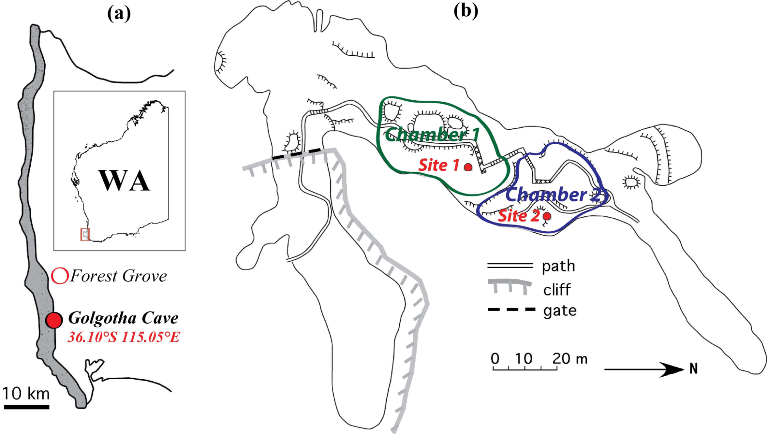
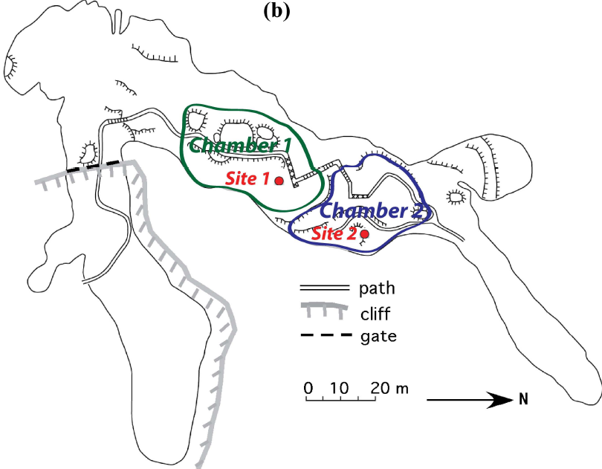
Site description
LiDAR Data acquisition
Notes:
The first slide provides a brief introduction of the Cave site with LiDAR data acquisition
The left Fig displays the SWWA map along with the coastal belt of dune calcarenite. The inset figure indicates SWWA region. And on the right I have the plan view of Golgotha cave with two large significant chambers (green and blue marked areas) and LiDAR positions (red dots).
Here you can see the site 1 cave ceiling topography with stalactite distribution from LiDAR capture. We have cropped the ceiling portion of our interest. The red colour specifies the higher ceiling elevation.
Similar illustration for site 2.
Now due to time restriction I would only focus on site 1 to illustrate the methodology and later I will show both the results.

Slide 3
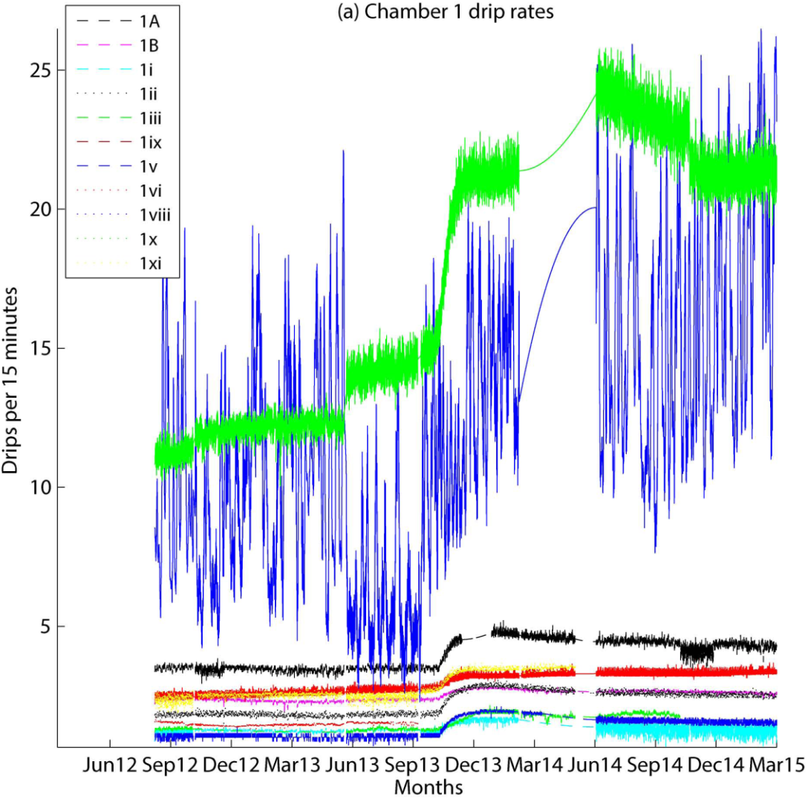
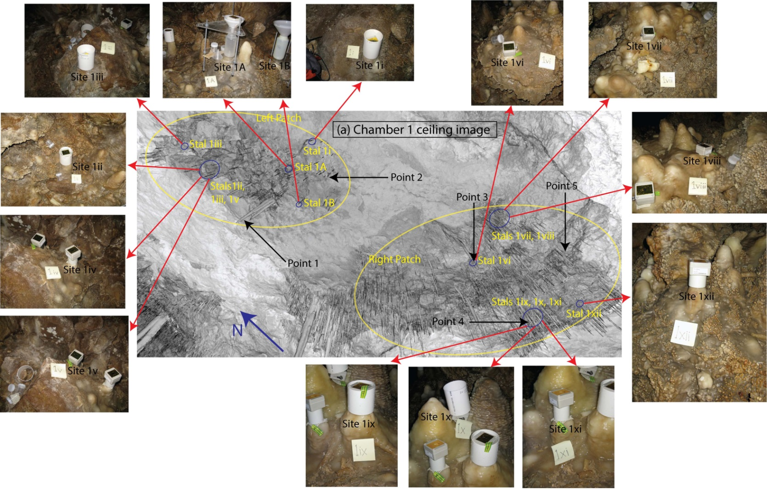
Drip data
Alignment of drip loggers and stalactites
Notes:
We installed a total of 34 drip water monitoring sites in the wettest areas of two large chambers of the cave.
This figure illustrates the drip time series for all drip loggers in chamber 1 for two and half hydrological years.
Now I will focus on the process of pairing the individual dripping stalactites with the loggers time series.
So the Figure shows the studied ceiling area above the loggers in chamber 1.
To locate the stalactites accurately we compared both the coordinates of the ceiling stalactites and the loggers on the floors, ideally both should have same x and y coordinates with different z values, and we further validate the positions with digital photos and on-site observations.
Blue circles indicate locations of the ceiling under which the loggers are placed, which are also pictured here and indicated by red arrows.

Slide 4
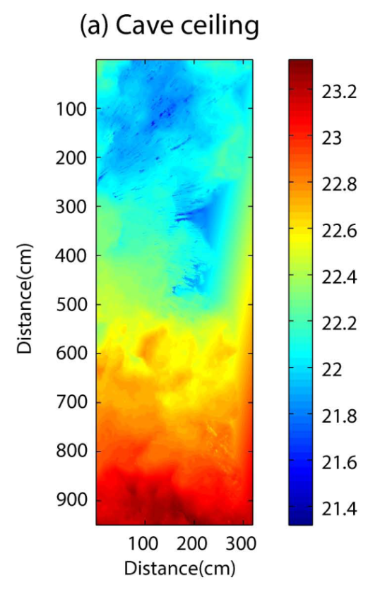
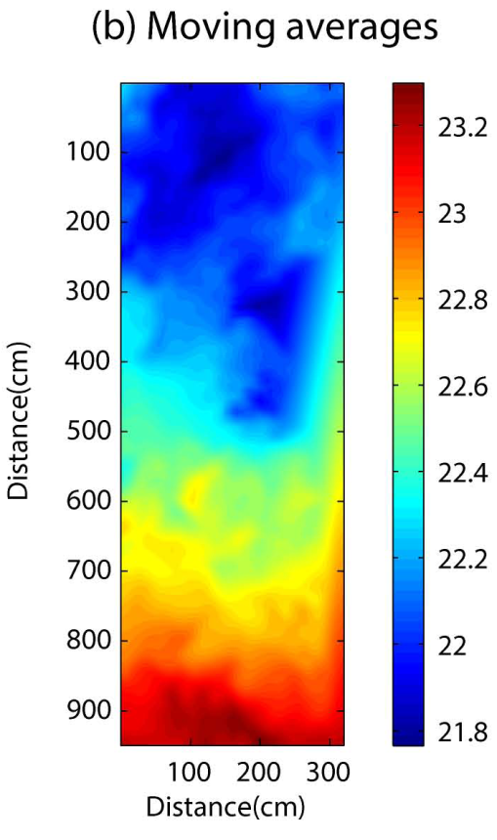
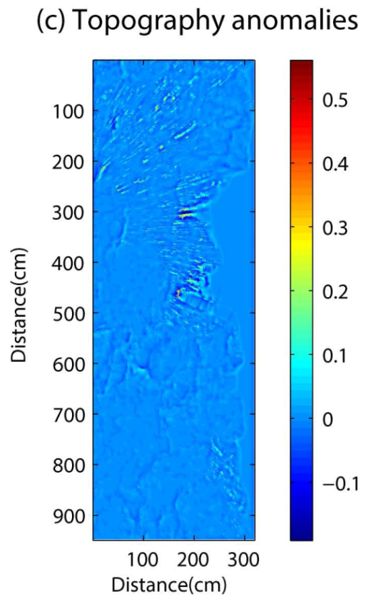
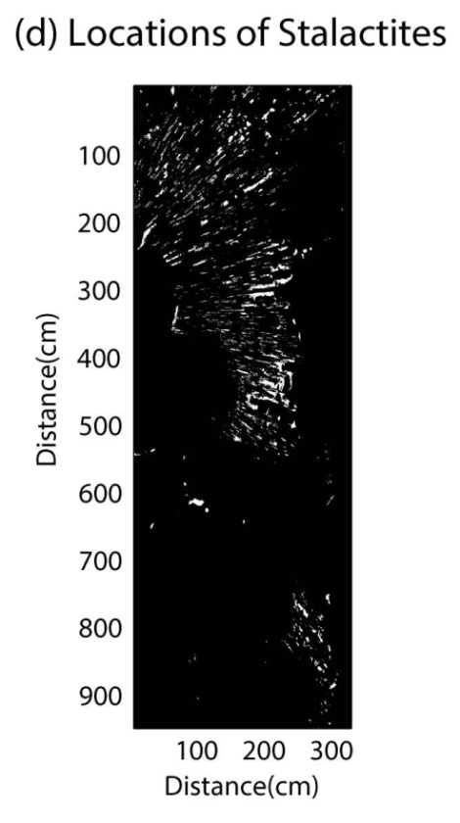
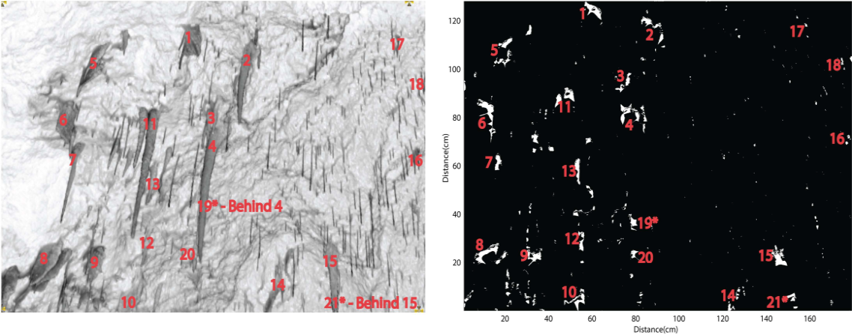
LiDAR image
Morphological analysis
Identify stalactites from Morphological analysis
Notes:
Now the process that we have used to identify individual stals from the LiDAR images with morphological analysis.
Fig a presents cave ceiling topography in 2D.
Fig b is the moving average of this ceiling surface with a window of 40 by 40 grid cells. Different possibilities for this window size have been tested, including a variogram analysis where the variogram range gives the size of the structure on the surface considered.
Then the Topography anomaly map is created by subtracting the smoothed surface from the ceiling topography.
To identify the locations of stalactites we then performed a thresholding operation. This threshold is defined based on the histogram of the Topography anomaly. Our tests showed that for the sites investigated in this study, a threshold defined as the 97th percentile of the topography anomalies allowed the appropriate identification of individual stalactites (vertical red line shown in this histogram plot). The anomalies lower than this threshold represent as natural rock surface variabilities. The white marks indicate the stalactite locations.
We validate the thresholding definition by counting the stalactites from both actual LiDAR images and the morphological analyses.

Slide 5
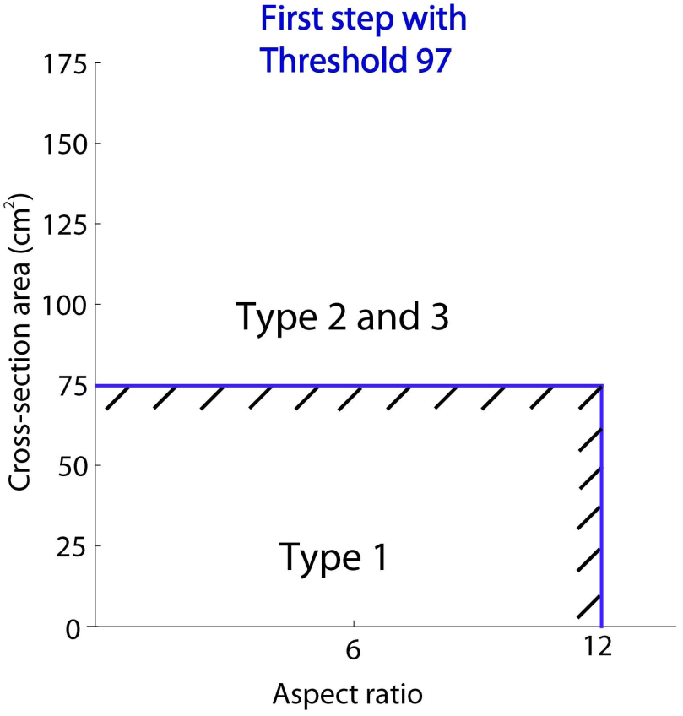
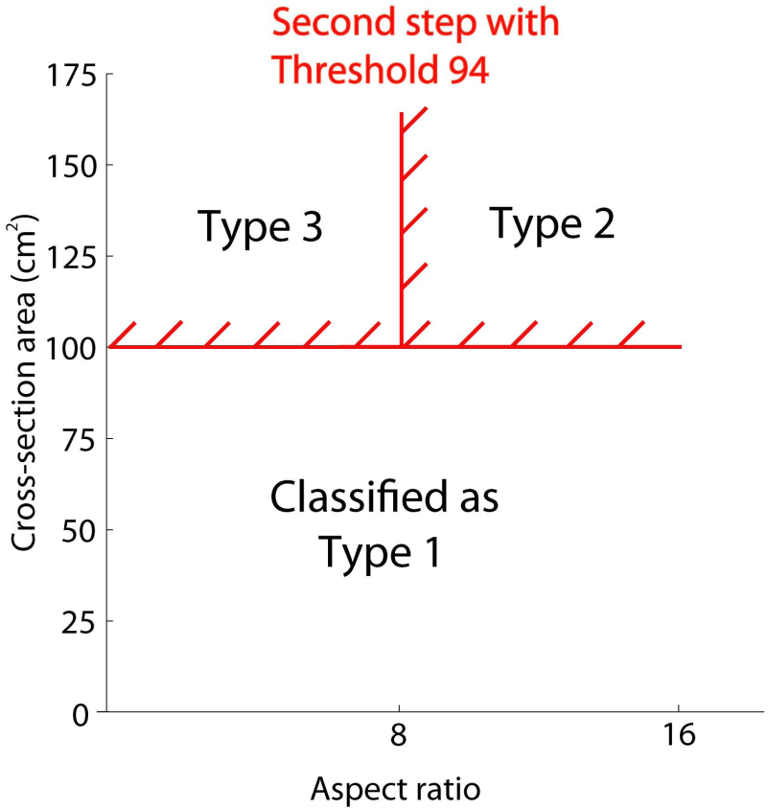
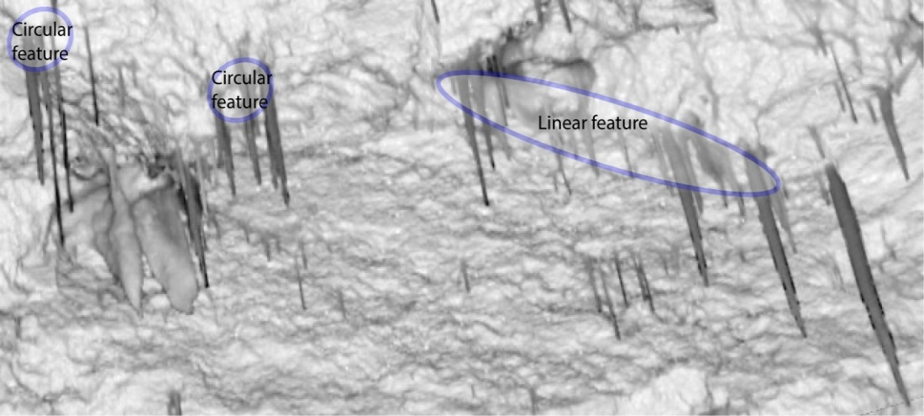
Icicle flow
Flow type 1: Matrix flow that includes small fractures
Flow type 2: Pure fracture flow
Flow type 3: Combination of conduit, fracture and matrix flow
Soda straw flow
Flow type classification based on LiDAR data
Notes:
Here is the brief discussion on the methodology that is used to classify different flow types based on LiDAR data.
We define four categories of flow and differentiate different types using two geometrical properties of stalactites: aspect ratio and cross-sectional area.
First type is the Matrix flow that is caused by water seeping through the rock matrix. This type is generally identified by individual stals that have both smaller cross-sectional area and aspect ratio. Using the threshold of 97th percentile that we have used before to identify the stal positions, matrix flows are defined with stal cross-sectional area < 75 cm² and the aspect ratio < 12.
This type is further subdivided into two: icicle and soda straw stalactite flows.
Soda straw flow are characterized by having a diameter of less than 10 mm with a length/diameter ratio greater than 8. And the rest are icicle flow.
The next types are pure fracture flow and combination of conduit, fracture and matrix flow.
We differentiate flow types 2 and 3 based on a lower threshold that corresponds to the 94th percentile of topography anomaly.
With this lower threshold, stalactites that are close to each other become grouped and form one large cluster.
This concept is illustrated in this Figure.
If a cluster has a large aspect ratio, it means that these stalactites have formed along a linear feature like a fracture or a fault (type 2), such as illustrated on the right side of this Fig.
On the other hand, if this large cluster has a smaller aspect ratio, it means that this cluster of stalactites has a more circular shape, indicating a combination of conduit, fracture and matrix flow (type 3), as on the left side of the Fig.
So the definition grid will be something like this where 100cm² equals to 75cm² with previous threshold of 97.

Slide 6

TABLE - Stalactite count validation
Type of flow | Stalactite Count
 | From actual LiDAR image | From morphological analysis
Icicle | ≈ 60 (visual count) | 62
Soda straw | ≈ 100 (visual count) | 81
Total | ≈ 160 (visual count) | 143
LiDAR image
Morphological analysis
Flow type classification based on LiDAR data
Notes:
To validate our approach, we manually counted different flow types visible in the high resolution LiDAR image and compared that to those features classified from the morphological analysis.
In this case we only have icicle shape and soda straw flows. Similar numbers in both columns obviously validate the technique.
Here is the final flow classification map we get for site 1 ceiling.

Slide 7
Relation between LiDAR-based classification and drip data
Notes:
To build a relationship between LiDAR-based classification and drip data, we focus only on the area of our interests.
For example, here we have the ceiling portion consisting stals 1A, 1B and 1i, all of these fall into icicle flows.
The next one has stals 1ii, 1iii and 1v. The first two are icicle however the last one categorized as soda straw flow.

Slide 8
Site/ Stalagmate | Elevation (ASL m) | Average drip rate per 15 minutes | LiDAR classified flow type | Skewness | Coefficient of variation (COV)
1A | 77.46 | 4.0 | Icicle | 0.17 | 18.23
1B | 77.424 | 2.5 | Icicle | -0.03 | 19.93
1i | 77.4 | 1.3 | Icicle | 0.13 | 40.31
1ii | 77.521 | 2.2 | Icicle | -0.06 | 28.09
1iii | 77.655 | 1.2 | Icicle | -0.29 | 30.52
1v | 77.585 | 1.3 | Soda-straw | 1.21 | 40.83
1vi | 77.036 | 1.5 | Icicle | 0.1 | 33.83
1viii | 77.167 | 12.1 | Combined | 0.38 | 42.49
1ix | 76.88 | 3.0 | Icicle | 0.23 | 21.01
1x | 76.9 | 17.2 | Fracture | 0.19 | 28.88
1xi | 76.885 | 2.5 | Icicle | -0.71 | 48.98
Site/Stalagmate | Elevation (ASL m) | Average drip rate per 15 minutes | LiDAR classified flow type | Skewness | Coefficient of variation (COV)
2A | 75.48 | 1.9 | Icicle | -0.24 | 44.31
2B | 73.49 | 3.4 | Icicle | 0.2 | 16.01
2E | 72.37 | 27.9 | Combined | -0.59 | 6.21
2i | 72.22 | 48.4 | Fracture | 0.31 | 2.57
2iii | 75.2 | 0.8 | Soda-straw | -1.64 | 45.62
2iv | 73.7 | 2.9 | Icicle | -0.82 | 13.23
2v | 75.75 | 13.5 | Combined | 0.10 | 5.65
2vi | 75.66 | 196.1 | Fracture | 0.44 | 100.95
2vii | 75.7 | 4.1 | Icicle | 0.03 | 21.63
2viii | 73.72 | 22.7 | Combined | -0.11 | 16.11
2ix | 73.34 | 71.7 | Fracture | -0.22 | 8.3
2x | 73.59 | 1.4 | Icicle | 0.5 | 43.86
2xi | 73.5 | 0.1 | Soda-straw | 2.68 | 289.31
2xiii | 73.54 | 5.2 | Icicle | -0.47 | 25.29
2xiv | 73.49 | 8.5 | Icicle | -0.17 | 11.81
2xv | 73.36 | 2.3 | Icicle | 0.56 | 21.57
2xvi | 73.52 | 53.8 | Fracture | 0.17 | 45.28
2xvii | 73.72 | 1.4 | Icicle | -0.06 | 53.08
Results and Discussion
Notes:
Once we have the LiDAR-based flow classification for individual sites, we listed all these in tabular form with other statistical characteristics.
However it is better to show the graphical representations of the results that we have.
In general, the drip rates satisfy the flow classification system. We have got low drip discharge for soda straws and high drips for fracture flows.
In terms of skewness, the soda straws have high values, and the COVs are spread out over the graph.
This Figure shows the correlation matrix for various drip sites with flow classification for both Chambers.
Different flow types characterized by the morphological analysis are shown in parenthesis.
The color scales indicate the correlation coefficient between drip time series.
From the correlation matrix we visualize significant relationships in terms of flow classifications and spatial distribution.

Slide 9
Actively dripping stalactite count. Red circles are stalactites identified as active in terms of dripping (displaying water droplets and/or white flashing at their tip) and yellow ones are inactive. On this photo, 32 red circles and 13 yellow ones are counted.
Parameters | Chamber 1 | Chamber 2
Average rainfall (mm/yr) | 1106
Average infiltration (mm/yr) | 696.27
Studied ceiling area (m²) | 30.4 (9.5 m x 3.2 m) | 55.2 (8.0 m x 6.9 m)
Total number of stalactites | 1909 | 2023
Density of stalactites per m² | 68 | 37
Proportion of active stalactites (%) | 57 | 76
Total flux volume (m³/yr) | 25.6 | 64.7
Flux per m² (mm/yr) | 840 | 1170
Equivalent area on ground surface (m²) | 36.8 | 92.9
Cave discharge estimation
Notes:
It is clear that not all stalactites are actively dripping, therefore to have an accurate quantification of the total drip flux we need to know the fraction of stalactites that are actively dripping.
This is done by looking at a series of the digital photos of the chamber ceiling to determine which stalactites have a water beads on their tip.
One single frame from chamber 1 ceiling is shown in this Figure. In this ceiling portion, there is a total of 45 stalactites, among which 32 are actively dripping (red circles) and yellow ones are inactive.
The table demonstrates the summary of results for both chambers considering the active stal percentages which is 57% for chamber 1 and 76% for chamber 2.
The average infiltration over the site is around 700 mm/yr, and the drip flux is 840 for site 1 and 1170 mm/yr for site 2.
Therefore the final representation of groundwater flow for the Tamala limestone formation in the Golgotha cave is shown in this fig.
(a) shows a vertical section of the entire cave with possible groundwater flows.
(b) and (c) illustrate close views of chambers 1 and 2 labelling areas of ground surface infiltration and drip discharge from cave ceilings (in red circle).
From the analyses and observations we find that the majority of the cave ceiling portion is dry in our cave site, suggesting the possibility of capillary effect with water moving around the cave rather than passing through it.

Slide 10
Thank you
Questions?
Email: kashif.mahmud@unsw.edu.au

